Slide 1
UMKC All-faculty meeting
March 15, 2016

Slide 2
Agenda
Opening remarks and State of the Campus Report – Chancellor Morton
Academic updates – Provost and Executive Vice Chancellor Bichelmeyer
Financial status - Vice Chancellor Lindenbaum
Faculty senate activities – Executive committee members Ward-Smith, Kilway, Wyckoff
Inter-Faculty Council (IFC) activities – Representatives Stancel and McArthur
Committee on Institutional Effectiveness – Representative Gogol
Questions

Slide 3
Chancellor Morton
Opening remarks and State of the Campus Report

Slide 4
Provost and Executive Vice-Chancellor Bichelmeyer
Academic updates

Slide 5
Vice-Chancellor Lindenbaum
Financial Status

Slide 6
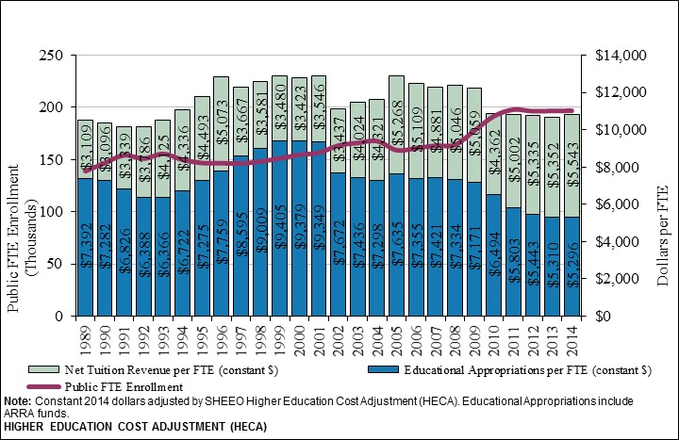
Public FTE Enrollment, Appropriations, & Tuition per FTE, MO

Slide 7
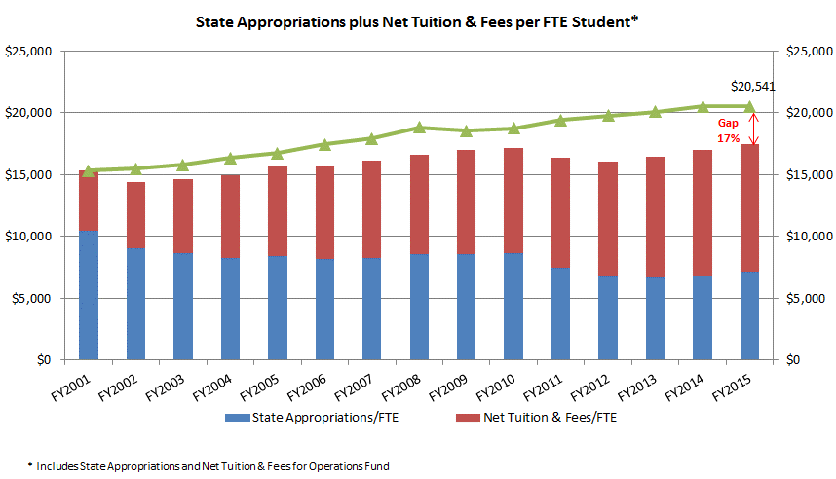
UM Per Student Revenue Decline since FY2001

Slide 8
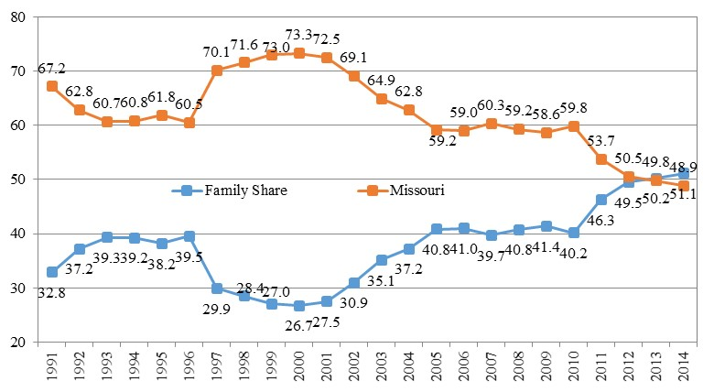
Family Share of Higher Education Operating Revenues, Missouri
SB389

Slide 9
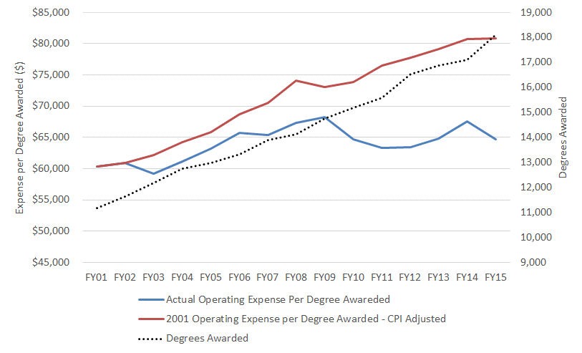
Reduction in Expense per Degree

Slide 10
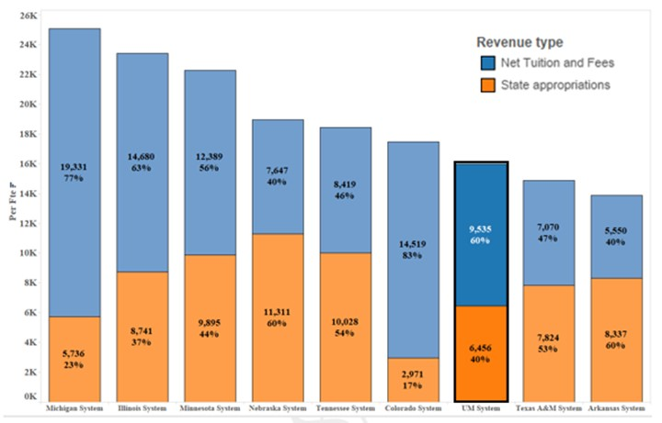
State Appropriations plus Net Tuition per FTE Peer Systems

Slide 11
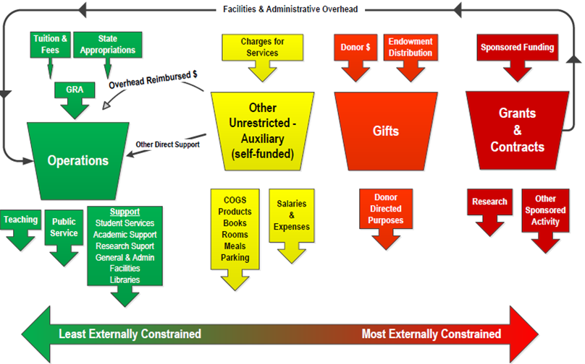
Color of Money Matters

Slide 12
FY16 Budget by Revenue Source All Budgeted Funds $347 million

Slide 13
FY16 Budgeted Revenues Operating Fund $237 million

Slide 14
FY16 Budgeted Expenses Operating Fund

Slide 15
FY16 Budgeted Revenues Auxiliary Funds $90 million

Slide 16
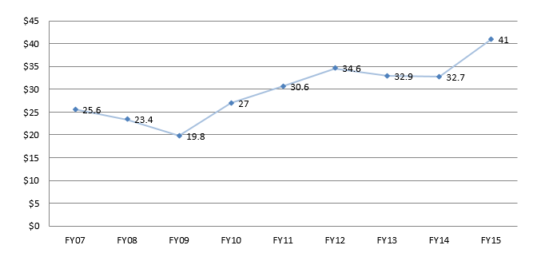
Operating Fund Reserves
FY14:
Current fund $84 M
Loan $26 M
Plant fund $174 M
Endowment $140 M
All Funds $426 M
Millions
Campus received $11.4 m in FY2010 for Caring for Missourians. Balances have been adjusted to exclude that one-time funding and corresponding expenses in subsequent years.

Slide 17
UMKC State Appropriations FY08 to FY16
In FY10, campus received $11.4 million in Caring for Missourians funding

Slide 18
UM System FY17 Appropriations Request
Core request $ 447.3 million
New requests 31.9 million
Other Curator programs 7.7 million
Legislative requirements 10.4 million
Total Request $ 497.3 million

Slide 19
New Appropriations Request
* Includes $1 million Missouri S&T and MSU cooperative mechanical engineer program. Other STEM programs with specific deliverables are being defined by MU, UMKC and UMSL.

Slide 20
FY17 Capital Appropriations Requests
Maintenance and Repair Priorities
$16.8 million for McKee Hall at MU
$16.3 million for Spencer Chemistry and Biological Sciences at UMKC (completes the buildings)
$37.9 million for
Schrenk Hall at Missouri S&T
$24.6 million for Stadler Hall at UMSL

Slide 21
Senate Activities

Slide 22
Senate Activities
Dean evaluations
Deans Medeiros, Postlethwaite, Vaught, White were evaluated FY16 and met with their faculty.
Deans Cary, Pyle, and Melchert, will be evaluated FY17
The instructions will include the fact that comments will be available, except for those that go directly to the Provost.
New Committees
CIE committee

Slide 23
Upcoming Vote Items
Vacant positions
Senate Chair / Chair elect
IFC Representative
Amendments to CRR
Faculty Senate Leadership Structure
Officer responsibilities
GER recommendations
Nominations close Friday, April 8th at 5PM (to Jerry Wyckoff)
Election will run from April 14th through the 29th
Results reported at the May 3 senate meeting

Slide 24
CRR 300.020.E.5 (Officers, Section A)
The Chairperson is the presiding officer of the Senate. It shall be the responsibility of the Chairperson to set the meeting schedule of the Senate and of the general Faculty meetings. The Chairperson shall be responsible for setting the agenda for both the Senate meetings and the general Faculty meetings, and for their distribution to all members of the voting Faculty. The agenda shall be set after consultation with the Senate Executive Committee. The Chairperson shall serve on the IFC during his/her term in office.
The Chair is the presiding officer of the Senate. It shall be the responsibility of the Chair to set the meeting schedule of the Senate and of the general Faculty meetings. The Chair shall be responsible for setting the agenda for both the Senate meetings and the general Faculty meetings, and for their distribution to all members of the voting Faculty. The agenda shall be set after consultation with the Senate Executive Committee, which consists of the Chair-elect, Chair, Past Chair and IFC representatives. The Chair shall serve on the IFC during his/her term in office.

Slide 25
Section B
The Vice Chairperson shall preside in the absence of the Chairperson.
The Past-Chair shall preside in the absence of the Chair, shall serve as the parliamentarian of the Senate, and shall be an ex-officio chair and member of the Election Committee to validate Faculty votes.

Slide 26
Section C
The Secretary shall record the minutes of the general Faculty meetings and the Senate meetings and shall distribute them to all Faculty members and shall make them available on-line through the Senate website. The Secretary shall excuse absences of Senate members and shall maintain attendance records.
The Chair-elect shall serve as secretary, and record the minutes of the general Faculty meetings and the Senate meetings, and shall distribute them to all Faculty members, and shall make them available on-line through the Senate website. The Chair-elect shall excuse absences of Senate members and shall maintain attendance records.

Slide 27
Section D
Should a Chairperson resign, that office will be assumed by the Vice Chairperson for the remainder of the year. Should the resignation occur during the first year of the term, a special election for Chairperson will be held to fill the one-year vacancy.
Should a Chair resign, that office will be assumed by the Chair-elect, and a special election for Chair-elect will be held to fill the vacancy for the remainder of the term. Should the Chair-elect resign, a new special election for Chair-elect will be held to fill the vacancy for the remainder of the term. Should the Past-Chair resign, the Senate will elect a Senator to fill the role and duties of the Past-Chair for the remainder of the term. In the case of a Chair resignation, the Chair-elect will serve out the remainder of the resigning Chair’s term for that year, and then serve the next year as Chair as if normal progression had occurred.

Slide 28
Section E
In the case of vacancies for all other officer positions, a ballot containing the names of the Senate members will be sent to all voting Faculty. The person getting the highest number of votes will assume the office for the duration of the unexpired term. Should that person be unable to serve, the person with the next highest number of votes will assume the office.
In the case of an IFC vacancy, the Senate shall determine at a regular meeting whether to fill the vacancy temporarily or for the duration of the unexpired term. For a temporary replacement, the Senate shall elect a current or prior Senate member to fill the vacancy. For replacements for the unexpired term, nominations will be requested among current or prior Senate members, and a ballot containing the names of nominees will be sent to all voting Faculty. The person getting the highest number of votes will assume the office for the duration of the unexpired term. Should that person be unable to serve, the person with the next highest number of votes in that election will assume the office. In urgent cases, so as to provide full representation at IFC, the Senate Executive Committee may appoint a current Senator to attend IFC meetings until the Senate can address the vacancy at its next regular or special meeting.

Slide 29
Section F
In the case of an IFC vacancy, the Senate shall determine at a regular meeting whether to fill the vacancy temporarily or for the duration of the unexpired term. For a temporary replacement, the Senate shall elect a current or prior Senate member to fill the vacancy. For replacements for the unexpired term, nominations will be requested among current or prior Senate members, and a ballot containing the names of nominees will be sent to all voting Faculty. The person getting the highest number of votes will assume the office for the duration of the unexpired term. Should that person be unable to serve, the person with the next highest number of votes in that election will assume the office. In urgent cases, so as to provide full representation at IFC, the Senate Executive Committee may appoint a current Senator to attend IFC meetings until the Senate can address the vacancy at its next regular or special meeting.
Faculty Senate Executive Committee members shall not serve more than two consecutive terms of office. Re-election would be at the level of Chair-elect.

Slide 30
Other changes 3. d. a.
Each school shall have a written set of Bylaws prepared in such a manner as is determined by the Faculty of that school. These Bylaws shall implement the provisions of this section of the UMKC Bylaws. A copy of these Bylaws and any subsequent amendment thereto shall be filed with the Chancellor and the Secretary of the Senate. The Bylaws shall not contain any provisions inconsistent with the UMKC Bylaws.
Changing Secretary to Past Chai

Slide 31
Other Changes E.5.b and E.5.d
The Vice Chairperson shall preside in the absence of the Chairperson.
Should a Chairperson resign, that office will be assumed by the Vice Chairperson for the remainder of the year. Should the resignation occur during the first year of the term, a special election for Chairperson will be held to fill the one-year vacancy.
Changing Vice Chairperson to Chair Elect
Changing Vice Chairperson to Chair Elect

Slide 32
General Education Amendments Recommendation One
The GECC has currently had last approval of all Gen Ed courses and Gen Ed course approval has bypassed the UCC.
The pace of new GE course approval has slowed down
The specific recommendation:
Modify the current Courseleaf approval process so that Gen. Ed. Courses go through BOTH the GECC and then the UCC.
This means GECC can focus solely on the Gen Ed items in courses.
If passed:
Courseleaf workflow is modified.
UCC becomes final Faculty approver for all courses, as it currently is for all non-Gen Ed courses.

Slide 33
Recommendation Two
The initial round of course assessment was unsustainable.
Every student in every course was assessed, every year.
Specific Recommendation:
Stagger so that 1/3 of courses is assessed each year and assess a sample of work.
If passed:
Each year, the following will be assessed:
One Anchor course level and their shared Discourse classes
One focus course SLO
Selected approximately 100 student artifacts from each course type
Select randomized artifacts

Slide 34
Recommendation Three
We heard from instructors that it was too much effort for them to perform assessment.
We also saw that assessment across courses was not standardized.
Specific Recommendation:
Standardize Gen Ed Assessment
If passed:
Create a panel that does assessment (similar to NIH study section), meets each summer
Panel collects assignments and course-specific rubrics, performs sampling
Panel uses standardized rubrics for each Gen Ed SLO
Instructors perform and return self-assessment/proposed change evaluation
Results go back to instructors and division/dept. heads

Slide 35
Recommendation Four
Change the name of the Discourse classes
The name causes confusion among students/transfers
Specific Recommendation:
Change the name of these courses from Discourse: Speech and Writing to Written and Oral Communication, dropping the term Discourse entirely.
If Passed:
The course names are altered in the catalog, literature, etc. as soon as practical.

Slide 36
Faculty Senate Committee on Institutional Efficiency (CIE)
Charge: Advise on maximizing efficiency of delivery (effectiveness at lowest cost) of administrative services that support the academic units in fulfilling the missions of the university
Supersedes a previous standing Faculty Senate committee (COSCO) that had not been active for some years

Slide 37
Purpose and Rationale
Each academic unit’s revenue allocation (tuition and state support) is assessed a “tax” to pay for administrative support
Maximizing efficiency:
=> best/most appropriate service
=> lowest cost (“tax”) maximizes resources for the academic units (i.e., teaching & research)

Slide 38
Current structure
Individual “task forces” that faculty and relevant administrative representatives
- examine organizational structure, budgets, and activities of specific support units
- develop metrics to gauge success & efficiency
Each task force prepares a report for faculty senate advising on current operations, and suggesting changes to increase efficiency
- approval by faculty senate
- forwarded to chancellor to consider implementing changes

Slide 39
Current activity
Four taskforces under CIE auspices, evaluating:
1. Advancement & Development
2. Intercollegiate Athletics
3. Office of Research Services
4. Student Affairs and Enrollment Management
Process developed this year will serve as a template for future administrative evaluations

Slide 40
Task Force members
1. Advancement: 2. Athletics:
Faculty: Faculty:
Ed Gogol (SBS) (point) Tony Luppino (Law) (point)
Shannon Jackson (A&S) Jimmy Adegoke (A&S)
Margaret Brommelsiek (SoN) Viviana Grieco (A&S)
Susan Sykes Berry (Libraries) Sullivan Read (SBS)
Dale Morehouse (Conservatory)
Allison Trout (SoM staff)
Administration: Administration:
Leo Morton (Chancellor) Leo Morton (Chancellor)
Curt Crespino (VC Advancement) Carla Wilson (Athletics Director)
Steven Norris (Pres. Foundation) Sharon Lindenbaum (VC, Admin)
Sharon Lindenbaum (VC, Admin) John Morrissey (Budget)
Karen Wilkerson (Budget)
Jeff Ross (Budget)

Slide 41
Task Force members
3. Office of Research Services: 4. Student Affairs/Enrollment:
Faculty: Faculty:
Anil Kumar (SoP) (point) Tom Mardikes(A&S) (point)
Sarah Dallas (SoD) Roger Pick (Bloch)
Mark Hecker (SoM) Jim Sturgeon (A&S)
Jennifer Lundgren (A&S) Karen Vorst (A&S)
Tom Menees (SBS)
Jeffrey Rydberg-Cox (A&S)
Administration: Administration:
Barbara Bichelmeyer (Provost) Leo Morton (Chancellor)
Lawrence Dreyfus (VC Research) Barbara Bichelmeyer (Provost)
Sharon Linindenbaum (VC Admin)) Sharon Lindenbaum (VC Admin)
Denis Medeiros (Graduate School) Mel Tyler (VC Student Affairs)
Tony Caruso(AVC, Research) Cary Chelladurai (Medicine)
Bob Crutsinger (Accounting) Jeff Ross (Budget)
Karen Wilkerson (Budget)

Slide 42
Plans for future year evaluations
Rotating 3-year evaluation schedule:
2016 – 2017:
University College
Online Learning
Diversity and Inclusion
Facilities Management
2017 - 2018:
Faculty Affairs
Provost and Chancellor
Information Services
Security / Campus Police

Slide 43
Future volunteers needed
Faculty Senate (and other faculty) have worked to get adequate faculty representation on the CIE task forces this year
Future years will require other faculty to replace those serving this year, with wide campus representation
Please consider donating some of your time and effort to work on this evaluation process next year

Slide 44
IFC Representatives Stancel and McArthur
IFC Update

Slide 45
Questions?

